Slide 1
INGREDO (Ingredient Detection App)
By:
Shaikh Akhsa (23)
Shaikh Jasmine(09)
Khadija Anam(07)
Shital Bansode(C11)
Guided by:
Prof Y.S. Pagar

Slide 2
CONTENTS:
Introduction
Abstract
Project Scope
Objectives
Features
Literature Survey
Existing System
Paper Studied
Proposed system
Software /Hardware Requirements
System Development (UML Diagrams)
Conclusion
References

Slide 3
PROBLEM DEFINITION
Unawareness of the healthy/dangerous ingredients present in packed products of food industries among the general public

Slide 4
INTRODUCTION
Abstract
To provide a platform with minimalistic and crisp interface and spread awareness to the general public about harmful/healthy ingredients in food/medical products and protect from long term diseases by using data mining.

Slide 5
Project Scope
Wide range of food products
Medical Products
Cosmetics
Food suggestion based on diseases
Resources
Magazines
Play Store
Research Papers
Al Rabie ( Saudi Food Company )

Slide 6
Objectives
To provide awareness about ingredients of products to the general public
To provide minimalistic user interface

Slide 7
Features
Scan the product
QR code
Barcode
Text
Shows details of scanned product
Healthy, Moderate, Unhealthy
On clicking on particular ingredient shows little bit of necessary information.
Information from legitimate and verified sources

Slide 8
LITERATURE SURVEY
EXISTING SYSTEMS
Is it Vegan?
Calorie scanner
Ingredient analysis
Ingred app

Slide 9
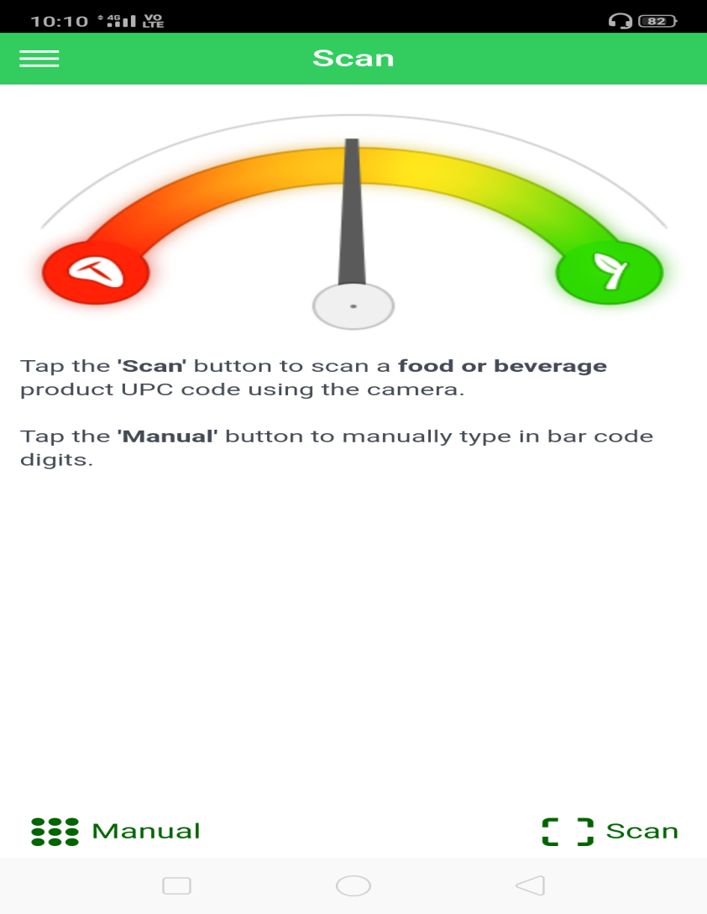
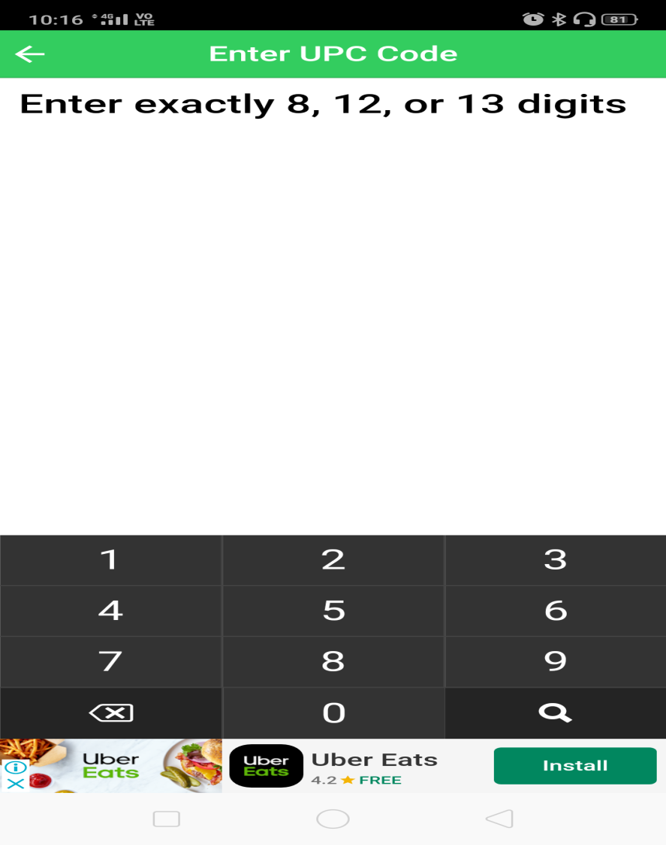
1.IS IT VEGAN?

Slide 10
Disadvantages
Uses meter
Scan only barcode
Does not show the ingredient information

Slide 11
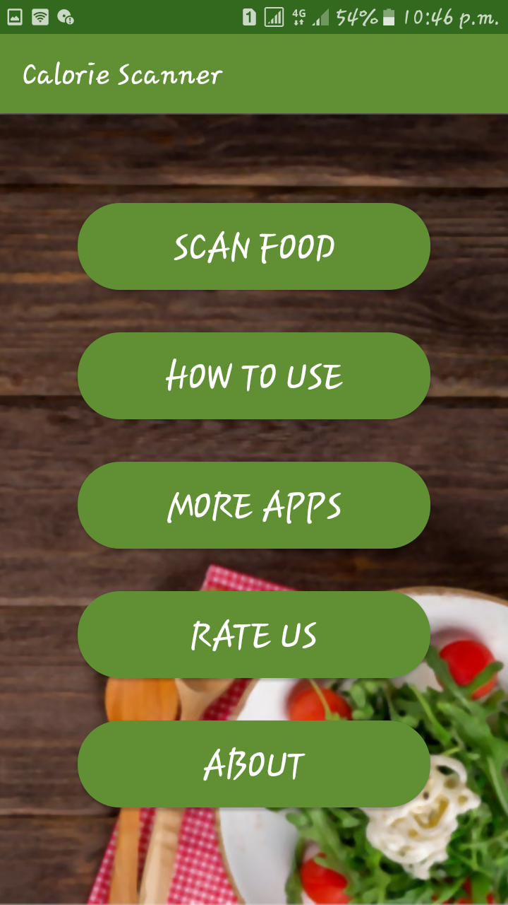
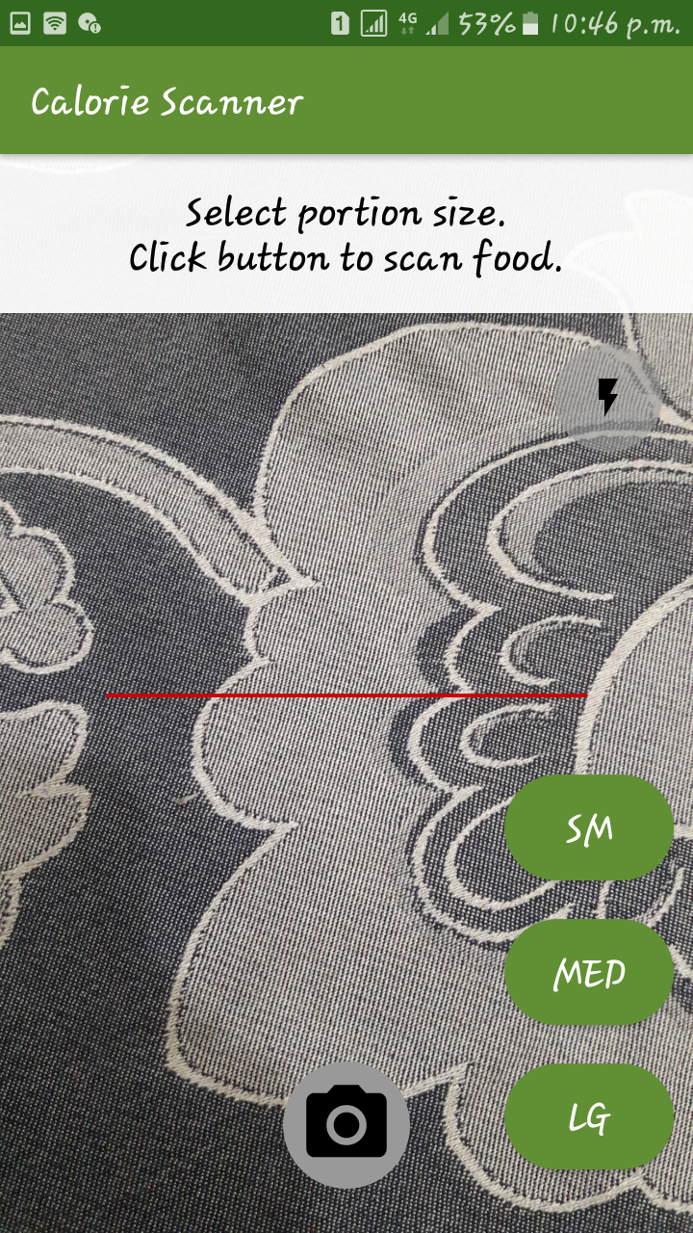
2.CALORIE SCANNER
Calorie Scanner is for scanning the product and check how much calorie the product is gaining.

Slide 12
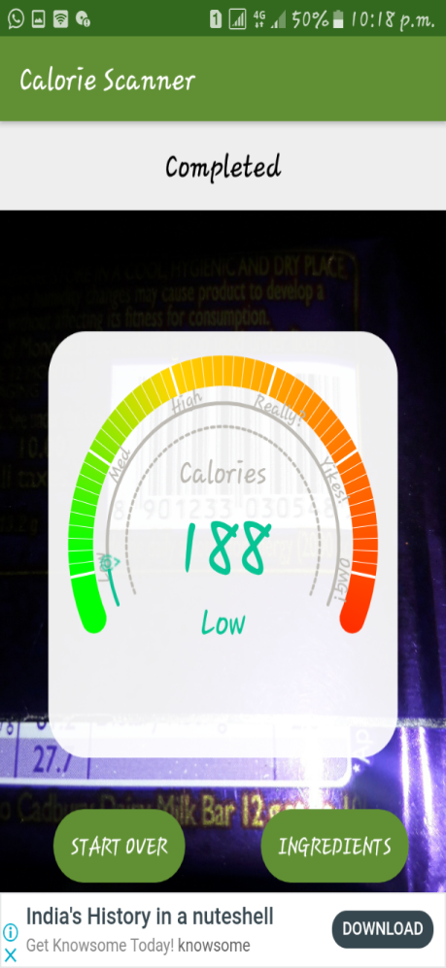
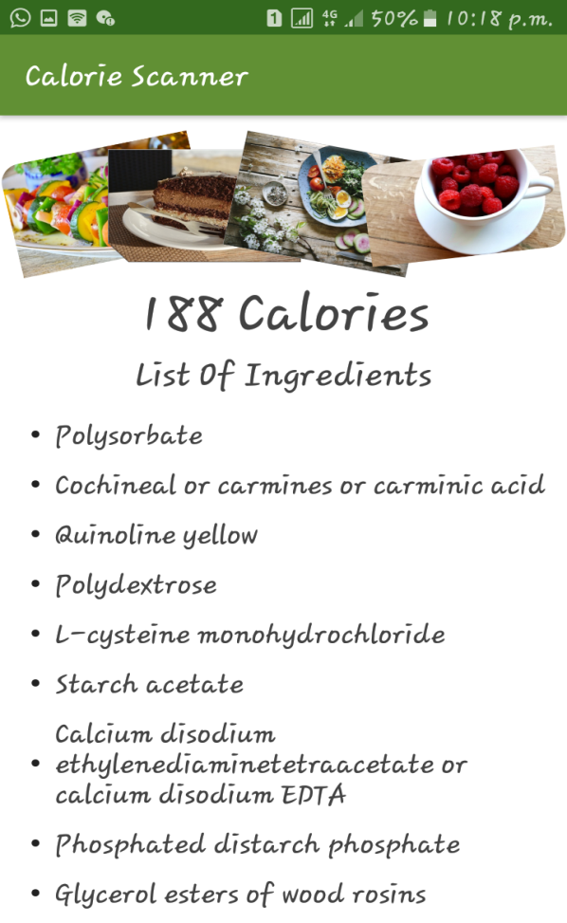
Products studied
Cadbury Product

Slide 13
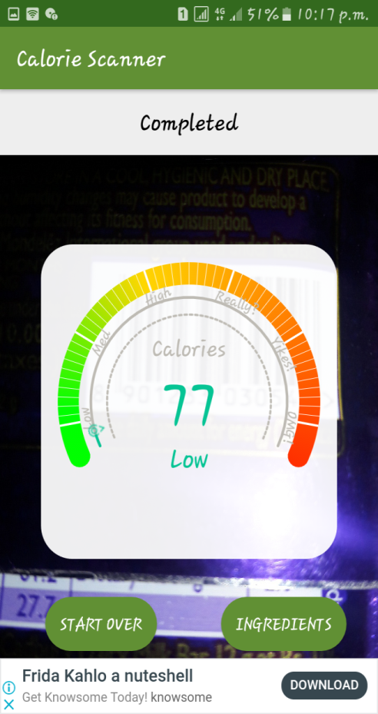
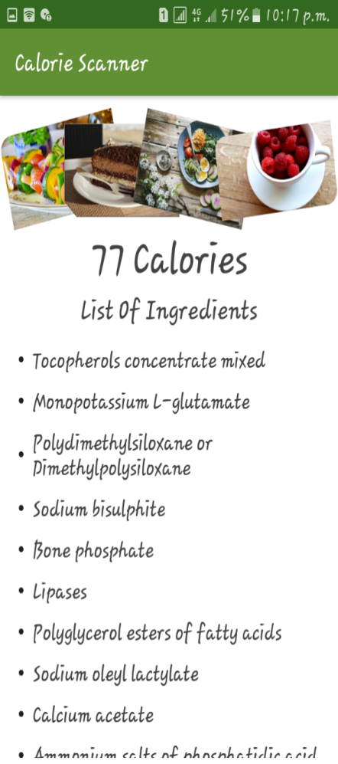
Blurred image / No Image

Slide 14
DISADVANTAGES
Scanning of Blur product also showing calories.
Dysfunctional App – Scan’s anything other than food and still shows calories counter.
Scanning a face then also showing a Calories.

Slide 15
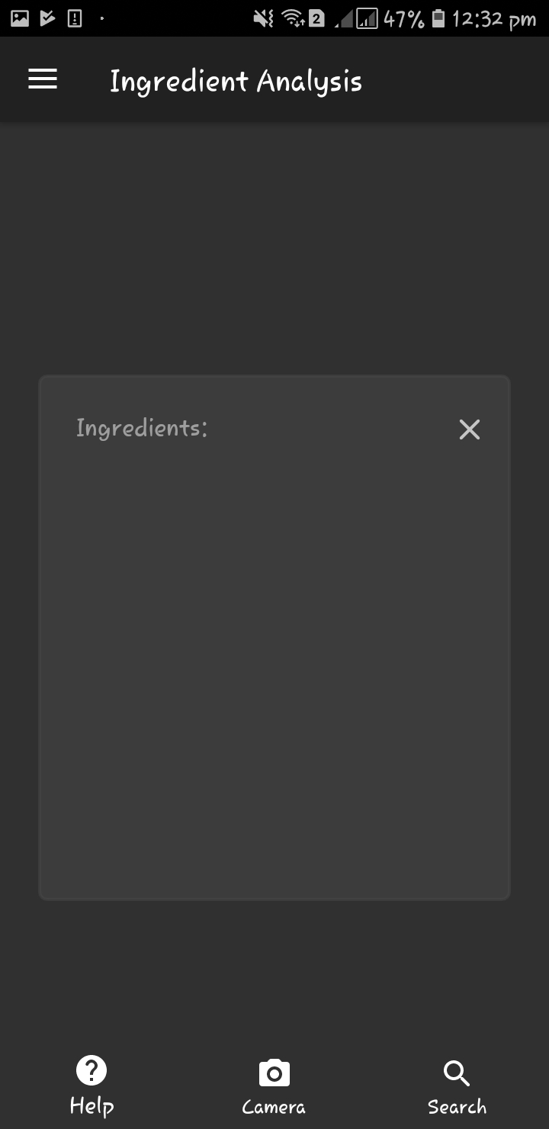
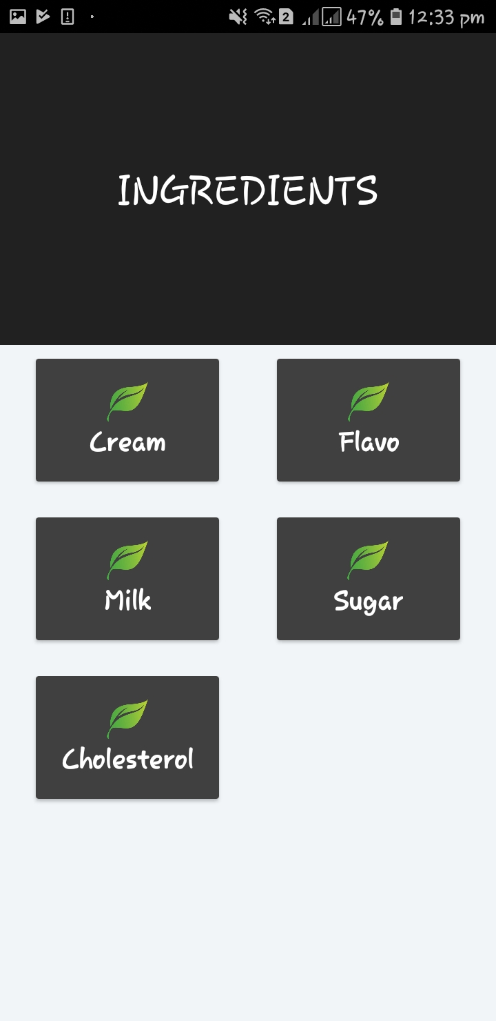
3. INGREDIENTS ANALYSIS

Slide 16
Disadvantages:
Does not differentiate between healthy and Unhealthy ingredients.
Does not Show minimum information of ingredients

Slide 17
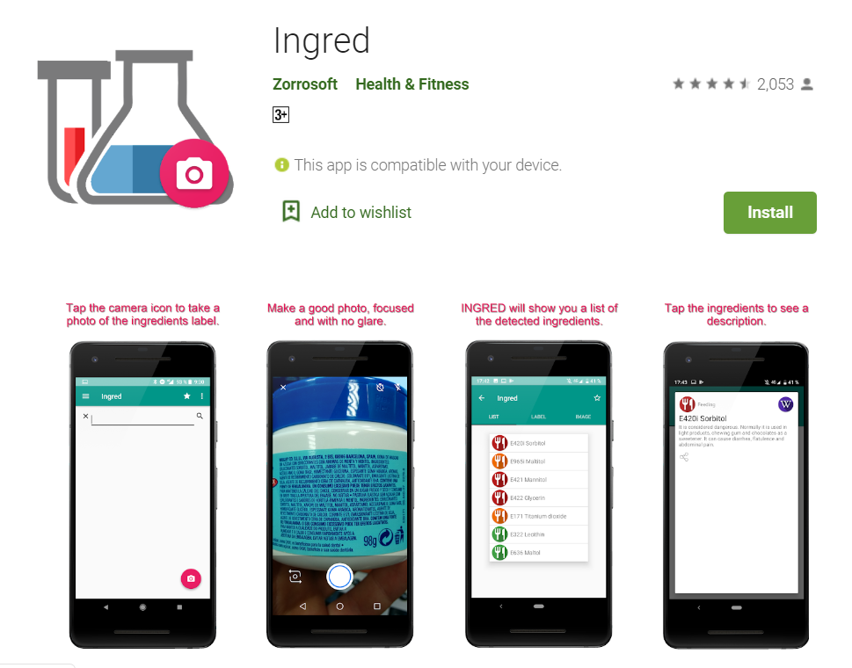
4.INGRED APP

Slide 18
DISADVANTAGES
Doesn’t give the precise information about the ingredients i.e from a recognised source
How do we overcome it?
Information from verified sources like
CODEX - The Codex Alimentarius
FSSAI- Food Safety and Standards Authority of India

Slide 19
PAPERS STUDIED
Institute for Agricultural and Fisheries Research (ILVO), Technology and Food Science Unit, Merelbeke,Belgium[September4, 2011 ] “Detection of Allergenic Ingredients Using Real-Time PCR: A Case Study on Hazelnut (Corylus avellena) and Soy (Glycine max)”
Ikramullah khosa,Eros pasero[07 October 2014]”Defect detection in food ingredients using Multilayer Perceptron Neural Network”

Slide 20
Abstract:
Detection of Allergenic Ingredients Using Real-Time PCR: A Case Study on Hazelnut (Corylus avellena) and Soy (Glycine max)”
Compliance with the European allergen labeling legislation (Directive 2007/68/EC) is only possible when coupled with appropriate methods to detect allergens in food.
Develop new real-time PCR(Polymerase chain reaction) assays for the detection of hazelnut and soy and evaluate these assays via comparison with commercially available kits
Assays were able to quantify as few as 5–15 genome copies.

Slide 21
Defect detection in food ingredients using Multilayer Perceptron Neural Network
ABSTRACT:
The objective is to develop an in-line defect detection system capable of detection and classification of raw food ingredients without any damage.

Slide 22
Proposed system
Used 3 types of scanners in single app.
Classification between healthy Moderate and unhealthy food.
Shows information regarding ingredient.

Slide 23
SOFTWARE/HARDWARE REQUIREMENT
SOFTWARE REQUIREMENT
Visual Studio/Android Studio
Android OS
Mobile vision API of Google play Service
Scanner
Weka tool.
Database
Firebase
HARDWARE REQUIREMENT
Android Devices

Slide 24
System Development
We have shown our system design through some diagrams:
Flow Chart.
ER Diagram.
Use-Case Diagram.
Sequence Diagram
Data flow Diagram.

Slide 25
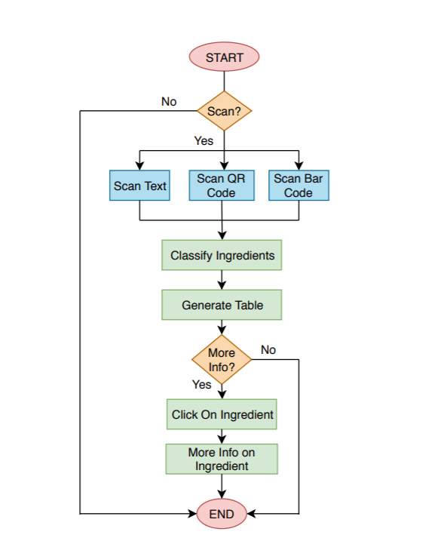
FLOW CHART Here we have shown how our system will flow:

Slide 26
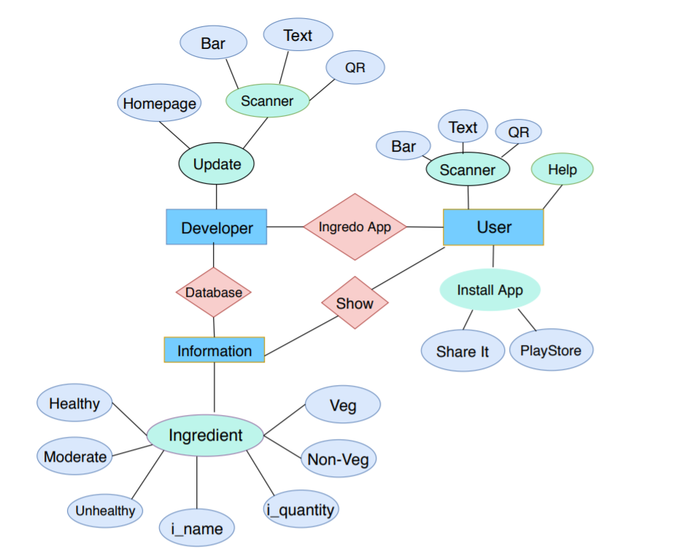
ER Diagram It Shows the Relationship between all Entities

Slide 27
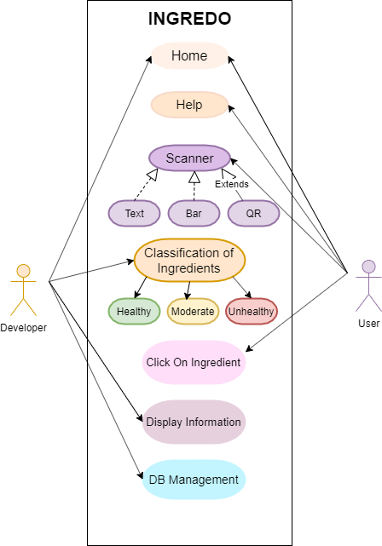
USE-CASE Diagram It will show what developer will do and what user will.

Slide 28
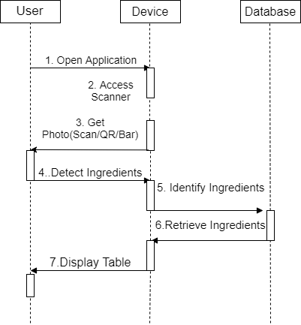
Sequence Diagram In this Diagram we are showing the sequence of our app

Slide 29
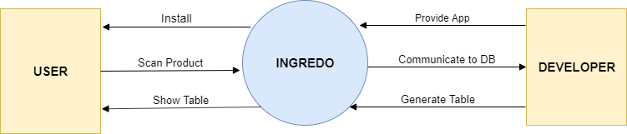
Data Flow Diagram
Level 0

Slide 30
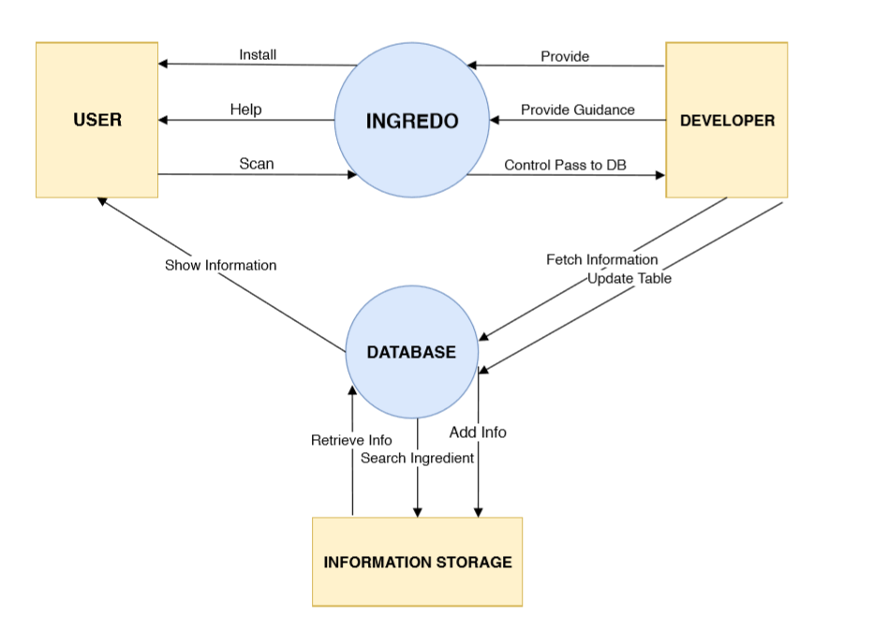
Data Flow Diagram
Level 1:

Slide 31
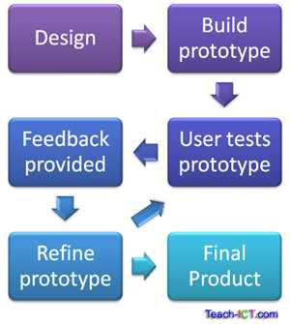
System Modelling:
Evolutionary Prototype:
Our Application will use the Evolutionary Prototype.

Slide 32
CONCLUSION
Thus we have studied , reviewed four apps related to food scanning and two research papers and designed the system through UML Diagrams.

Slide 33
REFERENCES
https://pubs.acs.org/doi/abs/10.1021/jf202110f
https://ieeexplore.ieee.org/document/6916782
https://play.google.com/store/apps/details?id=com.zorrosoft.android.ingred&hl=en_IN
https://play.google.com/store/apps/details?id=com.dancingdroid.foodcalorieestimator&hl=en_IN
https://play.google.com/store/apps/details?id=com.dancingdroid.foodcalorieestimator&hl=en_IN

Slide 34
THANK YOU

